Slide 1
Unsupervised Learning: Generation
Notes:
Next time:
https://hackernoon.com/how-to-autoencode-your-pok%C3%A9mon-6b0f5c7b7d97
Conditional VAE
GAN
Info GAN
Cool stuff
pracitcal

Slide 2












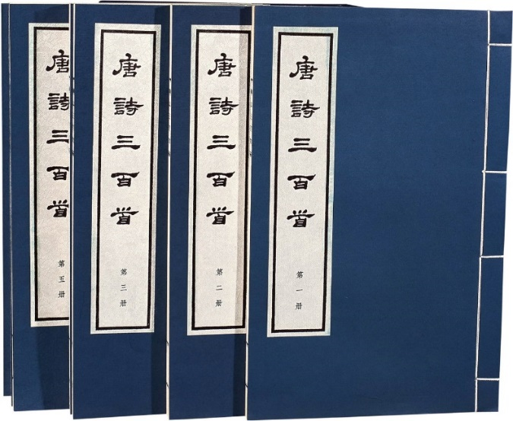
Creation
http://www.rb139.com/index.php?s=/Lot/44547
Drawing?
Writing Poems?
Notes:
就像教小朋友畫圖

Slide 3
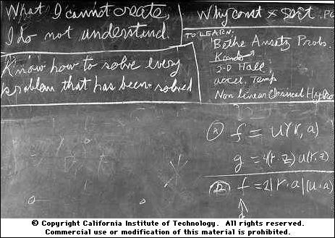
Creation
Generative Models: https://openai.com/blog/generative-models/
What I cannot create, I do not understand.
Richard Feynman
https://www.quora.com/What-did-Richard-Feynman-mean-when-he-said-What-I-cannot-create-I-do-not-understand

Slide 4
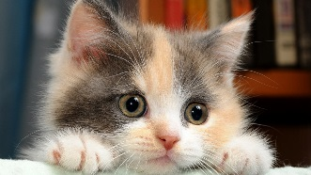
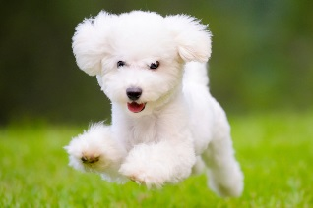
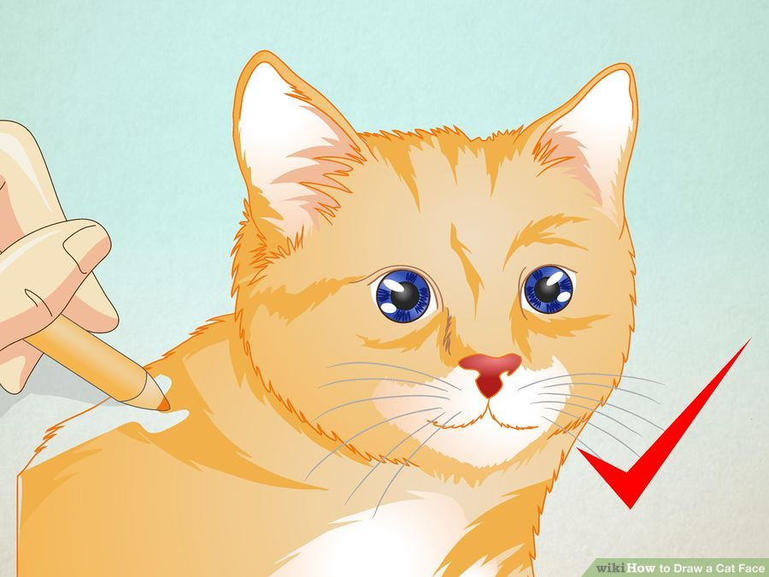
Creation
Now
v.s.
In the future
Machine draws a cat
http://www.wikihow.com/Draw-a-Cat-Face

Slide 5
Generative Models
Component-by-component
Autoencoder
Generative Adversarial Network (GAN)
Notes:
敵手的；對手的；對抗的

Slide 6
Component-by-component
Image generation
NN
E.g. 3 x 3 images
NN
NN
……
Can be trained just with a large collection of images without any annotation

Slide 7
Component-by-component
Image generation
NN
E.g. 3 x 3 images
NN
NN
……
Can be trained just with a large collection of images without any annotation

Slide 8
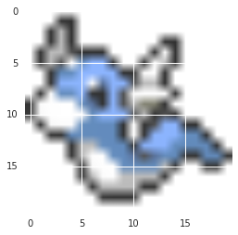
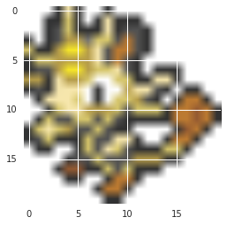
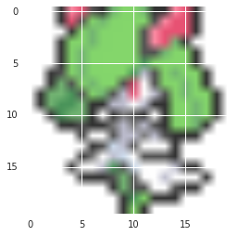
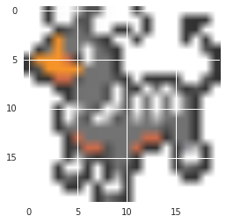
Practicing Generation Models: Pokémon Creation
Small images of 792 Pokémon's
Can machine learn to create new Pokémons?
Source of image: http://bulbapedia.bulbagarden.net/wiki/List_of_Pok%C3%A9mon_by_base_stats_(Generation_VI)
Don't catch them! Create them!
Original image is 40 x 40
Making them into 20 x 20

Slide 9
Practicing Generation Models: Pokémon Creation
Tips (?)
Each pixel is represented by 3 numbers (corresponding to RGB)
R=50, G=150, B=100
Each pixel is represented by a 1-of-N encoding feature
……
0 | 0 | 1 | 0 | 0
=
=
Clustering the similar color
167 colors in total

Slide 10
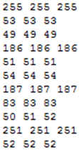
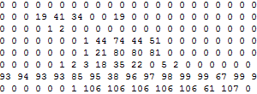
Practicing Generation Models: Pokémon Creation
Original image (40 x 40): http://speech.ee.ntu.edu.tw/~tlkagk/courses/ML_2016/Pokemon_creation/image.rar
Pixels (20 x 20): http://speech.ee.ntu.edu.tw/~tlkagk/courses/ML_2016/Pokemon_creation/pixel_color.txt
Each line corresponds to an image, and each number corresponds to a pixel
http://speech.ee.ntu.edu.tw/~tlkagk/courses/ML_2016/Pokemon_creation/colormap.txt
Following experiment: 1-layer LSTM, 512 cells
0
1
2
……
…

Slide 11
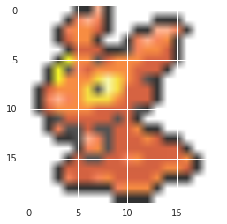
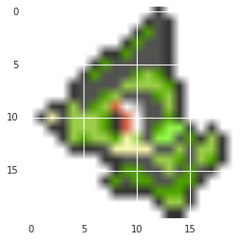
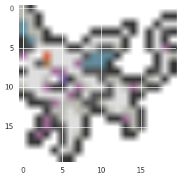
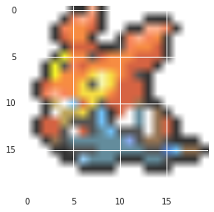
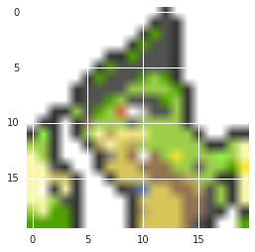
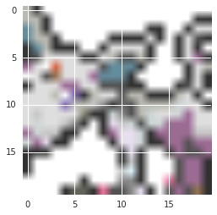
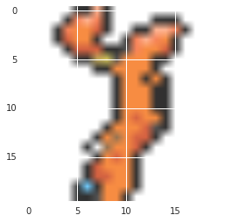
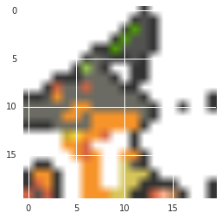
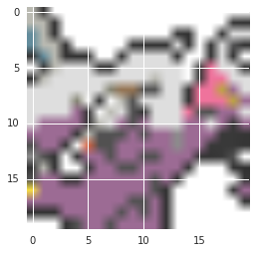
Real Pokémon
Never seen by machine!
Cover 50%
It is difficult to evaluate generation.
Cover 75%

Slide 12
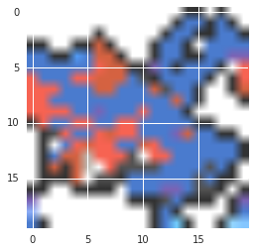
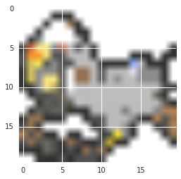
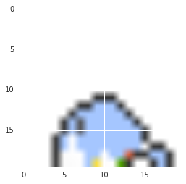
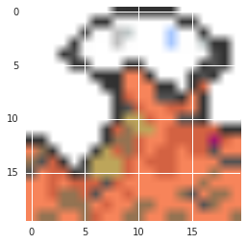
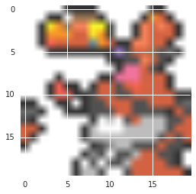
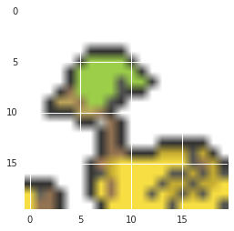
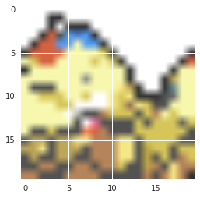
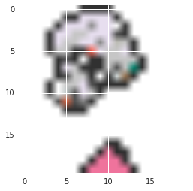
Pokémon Creation
Drawing from scratch
Need some randomness

Slide 13
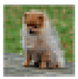
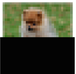
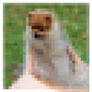
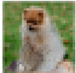
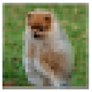
PixelRNN
Ref: Aaron van den Oord, Nal Kalchbrenner, Koray Kavukcuoglu, Pixel Recurrent Neural Networks, arXiv preprint, 2016
Real
World

Slide 14

More than images ……
Audio: Aaron van den Oord, Sander Dieleman, Heiga Zen, Karen Simonyan, Oriol Vinyals, Alex Graves, Nal Kalchbrenner, Andrew Senior, Koray Kavukcuoglu, WaveNet: A Generative Model for Raw Audio, arXiv preprint, 2016
Video: Nal Kalchbrenner, Aaron van den Oord, Karen Simonyan, Ivo Danihelka, Oriol Vinyals, Alex Graves, Koray Kavukcuoglu, Video Pixel Networks , arXiv preprint, 2016
Notes:
https://deepmind.com/blog/wavenet-generative-model-raw-audio/

Slide 15
Generative Models
Component-by-component
Autoencoder
Generative Adversarial Network (GAN)
Notes:
敵手的；對手的；對抗的

Slide 16
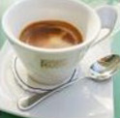
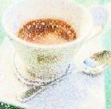
Auto-encoder
As close as possible
NN
Encoder
NN
Decoder
code
Randomly generate a vector as code
NN
Decoder
code
Image ?

Slide 17
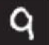
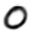
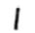
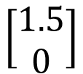
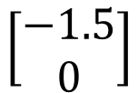
Review: Auto-encoder
2D
NN
Decoder
code
NN
Decoder
$$\left[\begin{aligned}1.5 \\ 0\end{aligned}\right]$$
-1.5
1.5
$$\left[\begin{aligned}−1.5 \\ 0\end{aligned}\right]$$
NN
Decoder
Notes:
SOM: http://alaric-research.blogspot.tw/2011/02/self-organizing-map.html

Slide 18
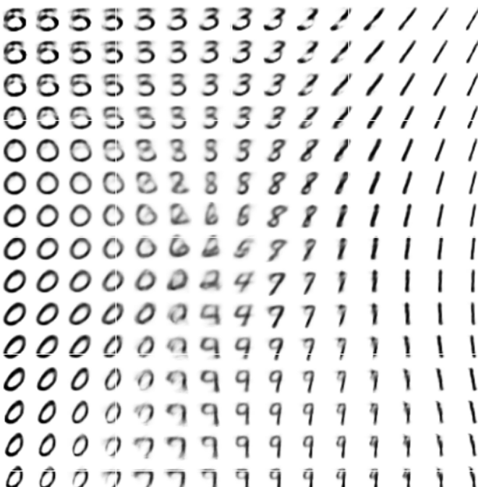
Review: Auto-encoder
-1.5
1.5
Notes:
SOM: http://alaric-research.blogspot.tw/2011/02/self-organizing-map.html

Slide 19
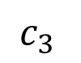
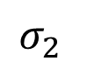
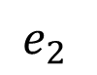
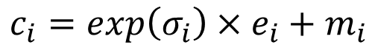
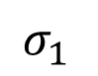
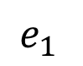
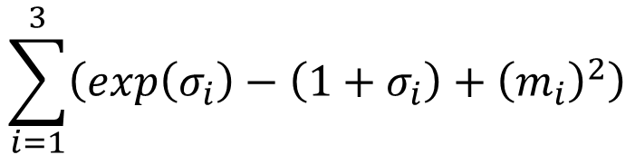
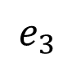
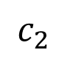


Auto-encoder
NN
Encoder
NN
Decoder
input
output
code
VAE
Minimize reconstruction error
m₁
m₂
NN
Encoder
m₃
$$c_{1}$$
input
NN
Decoder
$$σ_{1}$$
exp
+
$$c_{2}$$
output
$$σ_{2}$$
$$c_{3}$$
$$σ_{3}$$
X
$$c_{i}=exp\left(σ_{i}\right)×e_{i}+m_{i}$$
$$e_{1}$$
From a normal distribution
$$e_{2}$$
Minimize
$$e_{3}$$
$$\sum_{i=1}^{3}{\left(exp\left(σ_{i}\right)−\left(1+σ_{i}\right)+{\left(m_{i}\right)}^{2}\right)}$$

Slide 20






Why VAE?
What will happen if we only minimize reconstruction error?
Original
Code
Intuitive Reason
m₁
Code with noise
m₂
NN
Encoder
m₃
$$c_{1}$$
input
NN
Decoder
$$σ_{1}$$
exp
+
$$c_{2}$$
output
$$σ_{2}$$
$$c_{3}$$
$$σ_{3}$$
X
$$e_{1}$$
$$e_{2}$$
$$e_{3}$$
Minimize
$$\sum_{i=1}^{3}{\left(exp\left(σ_{i}\right)−\left(1+σ_{i}\right)+{\left(m_{i}\right)}^{2}\right)}$$
The variance of noise is automatically learned

Slide 21


Why VAE?
What will happen if we only minimize reconstruction error?
Original
Code
Intuitive Reason
m₁
Code with noisy
m₂
NN
Encoder
m₃
$$c_{1}$$
input
NN
Decoder
$$σ_{1}$$
exp
+
$$c_{2}$$
output
We want $σ_{i}$ close to 0 (variance close to 1)
$$σ_{2}$$
$$c_{3}$$
$$σ_{3}$$
X
$$e_{1}$$
$$e_{2}$$
$$e_{3}$$
Minimize
$$\sum_{i=1}^{3}{\left(exp\left(σ_{i}\right)−\left(1+σ_{i}\right)+{\left(m_{i}\right)}^{2}\right)}$$
The variance of noise is automatically learned
L2 regularization

Slide 22



Why VAE?
Intuitive Reason
?
decode
code
noise
noise
encode

Slide 23
Warning of Math

Slide 24




Gaussian Mixture Model
How to sample?
$$m\sim P\left(m\right)$$
(multinomial)
$$P\left(x\right)=\sum_{m}{P\left(m\right)P\left(x|m\right)}$$
m is an integer
$$x|m\sim N\left(μ^{m},Σ^{m}\right)$$
Each x you generate is from a mixture
Distributed representation is better than cluster.
P(x)
P(m)
1
2
3
4
5
…..
Notes:
How many Gaussin
A point from a Guassin

Slide 25








VAE
$$z\sim N\left(0,I\right)$$
z is a vector from normal distribution
Each dimension of z represents an attribute
$$x|z\sim N\left(μ\left(z\right),σ\left(z\right)\right)$$
NN
$$μ\left(z\right)$$
$$z$$
$$σ\left(z\right)$$
P(x)
$$P\left(x\right)=\int_{z}{P\left(z\right)P}\left(x|z\right)dz$$
Even though z is from $N\left(0,I\right)$, P(x) can be very complex
Infinite Gaussian
z

Slide 26











Maximizing Likelihood
P(z) is normal distribution
$$P\left(x\right)=\int_{z}{P\left(z\right)P}\left(x|z\right)dz$$
$$x|z \sim N\left(μ\left(z\right),σ\left(z\right)\right)$$
$μ\left(z\right),σ\left(z\right)$ is going to be estimated
$$L=\sum_{x}{logP\left(x\right)}$$
Maximizing the likelihood of the observed x
Tuning the parameters to maximize likelihood L
NN
$$μ\left(z\right)$$
$$z$$
$$σ\left(z\right)$$
Decoder
We need another distribution q(z|x)
NN’
$$μ′\left(x\right)$$
$$x$$
$$z|x \sim N\left(μ′\left(x\right),σ′\left(x\right)\right)$$
$$σ′\left(x\right)$$
Encoder

Slide 27








Maximizing Likelihood
P(z) is normal distribution
$$P\left(x\right)=\int_{z}{P\left(z\right)P}\left(x|z\right)dz$$
$$x|z \sim N\left(μ\left(z\right),σ\left(z\right)\right)$$
$μ\left(z\right),σ\left(z\right)$ is going to be estimated
$$L=\sum_{x}{logP\left(x\right)}$$
Maximizing the likelihood of the observed x
$$logP\left(x\right)=\int_{z}{q\left(z|x\right)logP\left(x\right)dz}$$
q(z|x) can be any distribution
$$=\int_{z}{q\left(z|x\right)log\left(\frac{P\left(z,x\right)}{P\left(z|x\right)}\right)dz}$$
$$=\int_{z}{q\left(z|x\right)log\left(\frac{P\left(z,x\right)}{q\left(z|x\right)}\frac{q\left(z|x\right)}{P\left(z|x\right)}\right)dz}$$
$$=\int_{z}{q\left(z|x\right)log\left(\frac{P\left(z,x\right)}{q\left(z|x\right)}\right)dz}+\int_{z}{q\left(z|x\right)log\left(\frac{q\left(z|x\right)}{P\left(z|x\right)}\right)dz}$$
$$KL\left(q\left(z|x\right)||P\left(z|x\right)\right)$$
$$≥\int_{z}{q\left(z|x\right)log\left(\frac{P\left(x|z\right)P\left(z\right)}{q\left(z|x\right)}\right)dz}$$
$$≥0$$
$$lower bound L_{b}$$

Slide 28










Maximizing Likelihood
$$logP\left(x\right)=L_{b}+KL\left(q\left(z|x\right)||P\left(z|x\right)\right)$$
$$L_{b}=\int_{z}{q\left(z|x\right)log\left(\frac{P\left(x|z\right)P\left(z\right)}{q\left(z|x\right)}\right)dz}$$
Find $P\left(x|z\right)$ and $q\left(z|x\right)$ maximizing L_{b}
$$KL$$
$$KL$$
$$logP\left(x\right)$$
$$logP\left(x\right)$$
$$L_{b}$$
Maximize $L_{b}$ by $q\left(z|x\right)$
$$L_{b}$$
$q\left(z|x\right)$ will be an approximation of $p\left(z|x\right)$ in the end

Slide 29









Maximizing Likelihood
P(z) is normal distribution
$$P\left(x\right)=\int_{z}{P\left(z\right)P}\left(x|z\right)dz$$
$$x|z \sim N\left(μ\left(z\right),σ\left(z\right)\right)$$
$μ\left(z\right),σ\left(z\right)$ is going to be estimated
$$L=\sum_{x}{logP\left(x\right)}$$
Maximizing the likelihood of the observed x
$$L_{b}=\int_{z}{q\left(z|x\right)log\left(\frac{P\left(z,x\right)}{q\left(z|x\right)}\right)dz}$$
$$=\int_{z}{q\left(z|x\right)log\left(\frac{P\left(x|z\right)P\left(z\right)}{q\left(z|x\right)}\right)dz}$$
$$=\int_{z}{q\left(z|x\right)log\left(\frac{P\left(z\right)}{q\left(z|x\right)}\right)dz}$$
$$+\int_{z}{q\left(z|x\right)logP\left(x|z\right)dz}$$
$$−KL\left(q\left(z|x\right)||P\left(z\right)\right)$$
$$z|x \sim N\left(μ′\left(x\right),σ′\left(x\right)\right)$$
NN’
$$μ′\left(x\right)$$
$$x$$
$$σ′\left(x\right)$$

Slide 30














Connection with Network
Minimize
$$\sum_{i=1}^{3}{\left(exp\left(σ_{i}\right)−\left(1+σ_{i}\right)+{\left(m_{i}\right)}^{2}\right)}$$
Minimizing
$$KL\left(q\left(z|x\right)||P\left(z\right)\right)$$
NN’
$$μ′\left(x\right)$$
(Refer to the Appendix B of the original VAE paper)
$$x$$
$$σ′\left(x\right)$$
Maximizing
$$\int_{z}{q\left(z|x\right)logP\left(x|z\right)dz}$$
$$=E_{q\left(z|x\right)}\left[logP\left(x|z\right)\right]$$
close
NN’
$$μ′\left(x\right)$$
$$μ\left(x\right)$$
$$x$$
$$x$$
$$z$$
NN
$$σ′\left(x\right)$$
$$σ\left(x\right)$$
This is the auto-encoder

Slide 31
End of Warning
Notes:
So many good explaination !!!!!!!!!!!!!!!!!
http://stats.stackexchange.com/questions/2691/making-sense-of-principal-component-analysis-eigenvectors-eigenvalues

Slide 32









Pokémon Creation
m₁
m₂
NN
Encoder
m₃
$$c_{1}$$
input
NN
Decoder
$$σ_{1}$$
exp
+
$$c_{2}$$
output
$$σ_{2}$$
$$c_{3}$$
$$σ_{3}$$
10-dim
X
$$e_{1}$$
$$e_{2}$$
Training
Pick two dim, and fix the rest eight
$$e_{3}$$
$$c_{1}$$
NN
Decoder
$$c_{2}$$
?
$$c_{3}$$
10-dim

Slide 33



Slide 34

Writing Poetry
NN
Encoder
NN
Decoder
sentence
sentence
code
Code Space
i went to the store to buy some groceries.
i store to buy some groceries.
i were to buy any groceries.
……
"come with me," she said.
"talk to me," she said.
"don’t worry about it," she said.
Ref: http://www.wired.co.uk/article/google-artificial-intelligence-poetry
Samuel R. Bowman, Luke Vilnis, Oriol Vinyals, Andrew M. Dai, Rafal Jozefowicz, Samy Bengio, Generating Sentences from a Continuous Space, arXiv prepring, 2015

Slide 35

Problems of VAE
It does not really try to simulate real images
NN
Decoder
Output
code
As close as possible
One pixel difference from the target
One pixel difference from the target
Realistic
Fake
VAE may just memorize the existing images, instead of generating new images

Slide 36
Generative Models
Component-by-component
Autoencoder
Generative Adversarial Network (GAN)
Ian J. Good fellow, Jean Pouget-Abadie, Mehdi Mirza, Bing Xu, David Warde-Farley, Sherjil Ozair, Aaron Courville, Yoshua Bengio, Generative Adversarial Networks, arXiv preprint 2014
Notes:
敵手的；對手的；對抗的

Slide 37

Cifar-10
Which one is machine-generated?
Ref: https://openai.com/blog/generative-models/
Notes:
CIFAR-10 samples also look very sharp - Amazon Mechanical Turk workers can distinguish our samples from real data with an error rate of 21.3% (50% would be random guessing):
Amazon Mechanical Turk workers can distinguish our samples from real data with an error rate of 21.3% (50% would be random guessing):

Slide 38


Yann LeCun’s comment
https://www.quora.com/What-are-some-recent-and-potentially-upcoming-breakthroughs-in-unsupervised-learning

Slide 39


Yann LeCun’s comment
……
https://www.quora.com/What-are-some-recent-and-potentially-upcoming-breakthroughs-in-deep-learning

Slide 40






Evolution
http://peellden.pixnet.net/blog/post/40406899-2013-%E7%AC%AC%E5%9B%9B%E5%AD%A3%EF%BC%8C%E5%86%AC%E8%9D%B6%E5%AF%82%E5%AF%A5
Kallima inachus
Brown
veins
Butterflies are not brown
Butterflies do not have veins
……..
Notes:
Vein
dried leaf

Slide 41





The evolution of generation
NN
Generator
v1
NN
Generator
v2
NN
Generator
v3
Discri-minator
v1
Discri-minator
v2
Discri-minator
v3
Real images:
Notes:
Binary
Classifier

Slide 42




Basic Idea of GAN
The data we want to generate has a distribution $P_{data}\left(x\right)$
$$P_{data}\left(x\right)$$
High
Probability
Low
Probability
Image
Space

Slide 43







Basic Idea of GAN
A generator G is a network. The network defines a probability distribution.
$$P_{G}\left(x\right)$$
$$P_{data}\left(x\right)$$
Normal Distribution
generator
G
$$z$$
$$x=G\left(z\right)$$
As close as possible
It is difficult to compute $P_{G}\left(x\right)$
We do not know what the distribution looks like.
https://blog.openai.com/generative-models/

Slide 44






Basic Idea of GAN
Normal Distribution
$$P_{G}\left(x\right)$$
NN
Generator
v1
0
0
0
0
$$P_{data}\left(x\right)$$
1
1
1
1
image
Discri-minator
v1
It can be proofed that the loss the discriminator related to JS divergence.
1/0

Slide 45

Basic Idea of GAN
Normal Distribution
NN
Generator
v1
Next step:
Updating the parameters of generator
To minimize the JS divergence
v2
The output be classified as “real” (as close to 1 as possible)
Discri-minator
v1
Generator + Discriminator = a network
Using gradient descent to update the parameters in the generator, but fix the discriminator
1.0
0.13

Slide 46
GAN – 二次元人物頭像鍊成
Source of images: https://zhuanlan.zhihu.com/p/24767059
DCGAN: https://github.com/carpedm20/DCGAN-tensorflow

Slide 47

GAN – 二次元人物頭像鍊成
100 rounds

Slide 48

GAN – 二次元人物頭像鍊成
1000 rounds

Slide 49

GAN – 二次元人物頭像鍊成
2000 rounds

Slide 50

GAN – 二次元人物頭像鍊成
5000 rounds

Slide 51

GAN – 二次元人物頭像鍊成
10,000 rounds

Slide 52

GAN – 二次元人物頭像鍊成
20,000 rounds

Slide 53

GAN – 二次元人物頭像鍊成
50,000 rounds

Slide 54

Why GAN is hard to train?
http://www.guokr.com/post/773890/
回到演化的比喻 ……
Better

Slide 55









Why GAN is hard to train?
$$P_{G_{0}}\left(x\right)$$
$$JS\left(P_{G_{1}}||P_{data}\right)=log2$$
$$P_{data}\left(x\right)$$
……
?
$$P_{G_{50}}\left(x\right)$$
$$JS\left(P_{G_{2}}||P_{data}\right)=log2$$
$$P_{data}\left(x\right)$$
Not really better ……
……
$$P_{G_{100}}\left(x\right)$$
$$P_{data}\left(x\right)$$
$$JS\left(P_{G_{2}}||P_{data}\right)=0$$

Slide 56





WGAN
Using Wasserstein distance instead of JS divergence
$$d_{0}$$
$$P_{G_{0}}\left(x\right)$$
$$W\left(P_{G_{1}}||P_{data}\right)=d_{0}$$
$$P_{data}\left(x\right)$$
……
$$d_{50}$$
Better
$$P_{G_{50}}\left(x\right)$$
$$W\left(P_{G_{2}}||P_{data}\right)=d_{50}$$
$$P_{data}\left(x\right)$$
……
$$P_{G_{100}}\left(x\right)$$
$$P_{data}\left(x\right)$$
$$W\left(P_{G_{2}}||P_{data}\right)=0$$

Slide 57
WGAN – 唐詩鍊成
NN
Generator
v1
NN
Generator
v2
NN
Generator
v3
哈哈哈哈哈…
低頭吃便當…
春眠不覺曉…
Discri-minator
v1
Discri-minator
v2
Discri-minator
v3
Real poems: 床前明月光，疑似地上霜，舉頭望明月，低頭思故鄉。
Notes:
Binary
Classifier

Slide 58
WGAN – 唐詩鍊成
由 李仲翊 同學提供實驗結果
Random generated
升雲白遲丹齋取，此酒新巷市入頭。黃道故海歸中後，不驚入得韻子門。
據口容章蕃翎翎，邦貸無遊隔將毬。外蕭曾臺遶出畧，此計推上呂天夢。
新來寳伎泉，手雪泓臺蓑。曾子花路魏，不謀散薦船。
功持牧度機邈爭，不躚官嬉牧涼散。不迎白旅今掩冬，盡蘸金祇可停。
玉十洪沄爭春風，溪子風佛挺橫鞋。盤盤稅焰先花齋，誰過飄鶴一丞幢。
海人依野庇，為阻例沉迴。座花不佐樹，弟闌十名儂。
入維當興日世瀕，不評皺。頭醉空其杯，駸園凋送頭。
鉢笙動春枝，寶叅潔長知。官爲宻爛去，絆粒薛一靜。
吾涼腕不楚，縱先待旅知。楚人縱酒待，一蔓飄聖猜。
折幕故癘應韻子，徑頭霜瓊老徑徑。尚錯春鏘熊悽梅，去吹依能九將香。
通可矯目鷃須浄，丹迤挈花一抵嫖。外子當目中前醒，迎日幽筆鈎弧前。
庭愛四樹人庭好，無衣服仍繡秋州。更怯風流欲鴂雲，帛陽舊據畆婷儻。
Notes:
http://leonli.eastasia.cloudapp.azure.com:8080/
CNN 32

Slide 59

Moving on the code space
Alec Radford, Luke Metz, Soumith Chintala, Unsupervised Representation Learning with Deep Convolutional Generative Adversarial Networks, ICLR, 2016

Slide 60


Moving on the code space
Ref: http://qiita.com/mattya/items/e5bfe5e04b9d2f0bbd47
Notes:
Practical

Slide 61
Text to Image
Generator
Text
Image
Scott Reed, Zeynep Akata, Xinchen Yan, Lajanugen Logeswaran, Bernt Schiele, Honglak Lee, “Generative Adversarial Text-to-Image Synthesis”, ICML 2016
Han Zhang, Tao Xu, Hongsheng Li, Shaoting Zhang, Xiaolei Huang, Xiaogang Wang, Dimitris Metaxas, “StackGAN: Text to Photo-realistic Image Synthesis with Stacked Generative Adversarial Networks”, arXiv prepring, 2016
Scott Reed, Zeynep Akata, Santosh Mohan, Samuel Tenka, Bernt Schiele, Honglak Lee, “Learning What and Where to Draw”, NIPS 2016
Notes:
https://github.com/paarthneekhara/text-to-image

Slide 62


Text to Image
"red flower with black center"

Slide 63



Text to Image
由 曾柏翔 同學提供實驗結果
E.g. 根據文字敘述畫出動漫人物頭像
Red hair, long hair
Black hair, blue eyes
Blue hair, green eyes

Slide 64
Image-to-image Translation
Phillip Isola, Jun-Yan Zhu, Tinghui Zhou, Alexei A. Efros, “Image-to-Image Translation with Conditional Adversarial Networks”, arXiv preprint, 2016
Notes:
Façade門面,正面,外觀,虛設的外表
That is the facade of the Palace. 那是宮殿的正面

Slide 65
Image-to-image Translation - Results

Slide 66
Cycle GAN
https://arxiv.org/abs/1703.10593

Slide 67
Disco GAN
https://arxiv.org/abs/1703.05192

Slide 68


機械学習で美少女化 ~ あるいはNEW GAME! の世界
http://qiita.com/Hi-king/items/8d36d9029ad1203aac55

Slide 69
So many GANs …… Just name a few
Modifying the Optimization of GAN
fGAN
WGAN
Least-square GAN
Loss Sensitive GAN
Energy-based GAN
Boundary-seeking GAN
Unroll GAN
……
Different Structure from the Original GAN
Conditional GAN
Semi-supervised GAN
InfoGAN
BiGAN
Cycle GAN
Disco GAN
VAE-GAN
……
Notes:
Application:
deep convolutional generative adversarial networks (DCGANs)

Slide 70
Acknowledgement
感謝 Ryan Sun 來信指出投影片上的錯字

